Slide 1
Panther Shuttle App
Joey Hilte – Chase Monigle – Tony Arrington – John Suo
Faculty Advisor(s): (their name/s), Dept. of ____, Florida Institute of Technology
INSTRUCTIONS
Do not use a color background
Keep all content within the gold lines and blue and crimson bars (other than title block and icons)
Do not change the size of the poster
Please keep the text readable. The only font allowed is “Calibri”. It is available on all Microsoft products . Minimum font size is 48 pts.
The size is already set to exactly the print size. Please arrange and size all the images and text properly.
Ensure that all images are at least 300 dpi
The name of any faculty should be put in as “Dr. [First Name] [Middle Initial]. [Last Name], Dept. Of [name of department], [name of institution]
Names of any sponsors, mentors, volunteers, helpers, etc. can be put in the acknowledgements section. Put in text only. Do not put in any additional logos in the poster other than the ones already in the template.
Your Poster file should be named as follows:
SHOWCASE_SPRING2024_POSTER_CAPSTONE MAJOR_YOURTEAMNAME*
(Example: SHOWCASE_SPRING2024_POSTER_ME_SUNNUCLEAR)
Note: The project name should be exactly as the registered project name.
*If this is an individual project, please place the title of your project instead of the team name
Please follow all instructions above.
The submission may be rejected if the formatting guidelines are violated or the file is not properly named.
**delete this text box**

Slide 2
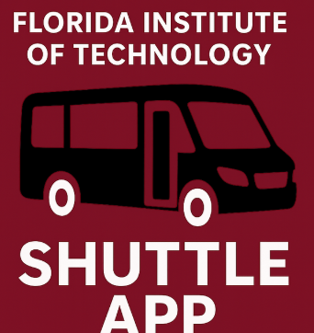
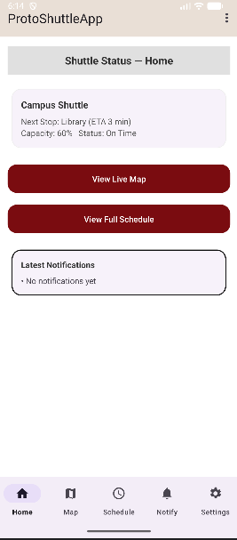










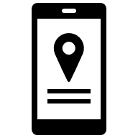



Panther Shuttle App
Joey Hilte – Chase Monigle – Tony Arrington – Jonathan Suo
Faculty Advisor: Dr. Khaled Slhoub, Dept. of Electrical Engineering and Computer Science Florida Institute of Technology
INTRODUCTION
SYSTEM ARCHITECTURE
MOBILE APP INTERFACE
Florida Tech students rely on the campus shuttle system to travel between dorms, classrooms, and nearby housing areas. However, existing tools do not provide reliable real-time tracking or notifications about delays.
The Panther Shuttle App provides students with live shuttle locations, schedules, and alerts to improve campus transportation and reduce wait times.
Student
Driver
Google API
Displays Map
Tracks Shuttle Location
Firebase
Stores User Data
Store Shuttle Data
Shuttle Manager
Use Case Diagram
KEY FEATURES
Manager Student Driver
Estimated Arrival Times
Home Page
System Workflow
Shuttle Route Map
Live Shuttle Location
Delay Alerts
Drivers
Phone
Backend
API
Google
API
Shuttle Schedule
Updates Stops
Updates Schedule
Backend Code Access
Updates Location
Manage Stops
Sends Alerts
Track Shuttle
View Schedule
Student
Phone
Costume Notifications
CONCLUSION
The Panther Shuttle App helps Florida Tech students:
easily track campus transportation
Uses real-time GPS tracking for accurate shuttle locations
Integrates schedule data for better planning
Provides automated notifications for updates and alerts
Improves overall accessibility and convenience for users

